Slide 1
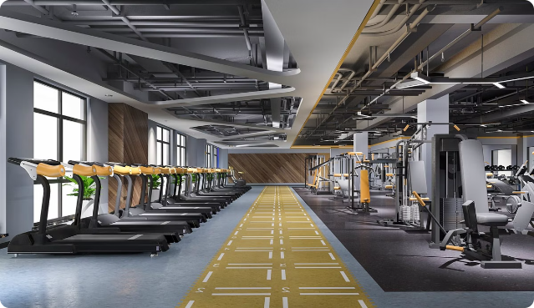
Online gym management system
Team Members: Pooja Amanchi
Prachi Chhatrola
Divya Solanki
Guide Name: Suramya Biswas

Slide 2
Content
Project Overview
Features
Modules
Functionalities
Tech Stack
ER Diagram
Future Enhancement
Conclusion

Slide 3

project overview The gym management system is a web-based application designed to manage the operations of a gym efficiently. Built using java spring boot,MySQL, and JSP, the system provides an easy-to-use interface for gym administrators to manage members, classes, and schedules. This application streamlines administrative tasks, improves communication between staff and members, and ensures a smooth operation of the gym’s day-to-day activities.

Slide 4
Features
Member Management
Slot scheduling and management
Authentication and Authorization
User Feedback

Slide 5
MODULES
ADMIN MODULES:
Manage items
Manage slots
Manage booking
Manage users
Manage slot reports
Review user feedback
MEMBER MODULES:
View and book slots
Cancel bookings
Provide feedback on services and
facilities

Slide 6
Functionalities
User and Admin:
Register: Users and admins can create new accounts.
Login: Users and admins can log in to the system.
Slot Booking: Users and admins can book available slots for gym sessions.
Cancel Booking: Users and admins can cancel previously booked slots.
Admin Only:
Manage Slot: Admins can create, update, and delete gym session slots.
Manage Gym Items: Admins can manage the gym equipment and items.
Manage Users: Admins can manage user accounts, including adding, updating, and removing users.
Feedback:
Given by User: Users can provide feedback on gym services and facilities.
Viewed by Admin: Admins can review user feedback.

Slide 7










TECH STACK
Frontend:
Backend:
Database:
Build Tool:
Code Editor:
Server:

Slide 8
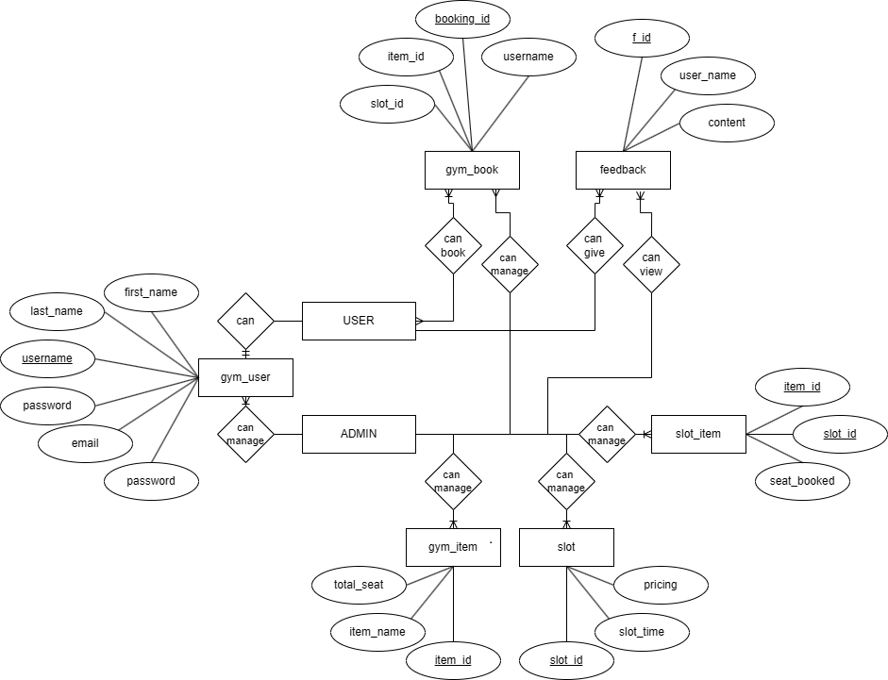
ER DIAGRAM

Slide 9
FUTURE ENHANCEMENT
Mobile Application Integration
Advanced Analytics and Reporting
AI-Powered Personalization
Wearable Devices Integration
Health and Fitness Tracking / Nutrition Tracking and Meal Planning
Enhance Member Engagement

Slide 10

Conclusion In conclusion, the gym management system using spring boot is a comprehensive solution that addresses the key challenges faced by gym administrators and members. It enhances operational efficiency, improves member engagement, and provides a solid foundation for future growth and innovation.

Slide 11


THANK YOU

